Slide 1
I
N
T
R
O
D
U
C
T
I
O
N
T
O
G
R
A
P
H

Slide 2
Exercise 15.1

Slide 3
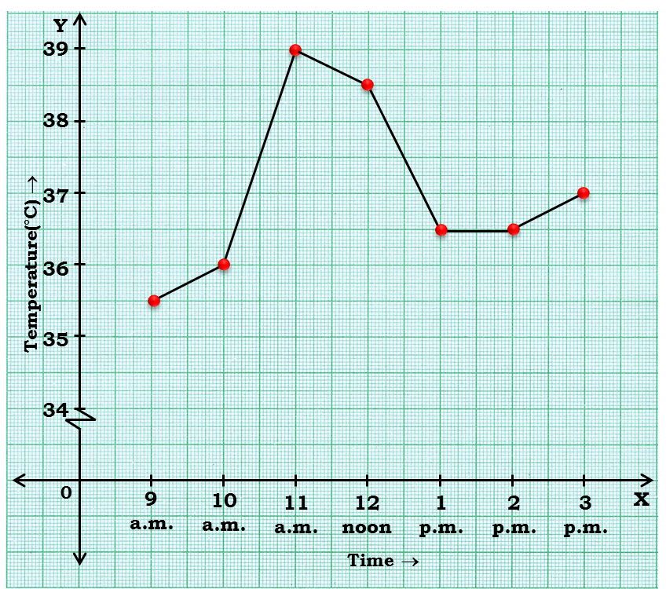
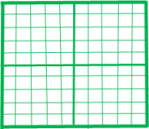
1
The following graph shows temperature of a patient in a hospital, recorded every hour.
(a) What was the patient’s temperature
at 1 p.m. ?
39
Sol :
38.5
The patient’s temperature was 36.5° C at 1 p.m.
38
37
(b) When was the patient’s temperature
38.5°C ?
36.5
Sol :
36
The patient’s temperature was 38.5° C at 12 noon.
(c) The patient’s temperature was the same two times during the period
given. What were these two times ?
Sol :
The patient’s temperature was the same two times between
1 p.m to 2 p.m.

Slide 4
1
The following graph shows temperature of a patient in a hospital, recorded every hour.
(d) What was the temperature at
1.30 p.m.? How did you arrive at
your answer ?
Sol :
The temperature at 1.30 p.m. is 36.5° C.
37
The point between 1 p.m. and 2 p.m., x-axis is equidistant from the two points showing 1 p.m. and 2p.m. So it represents 1.30 p.m. Similarly the point on y-axis, between 36°C and 37°C will represent 36.5° C.
36.5
36
1
1.30
2

Slide 5
1
The following graph shows temperature of a patient in a hospital, recorded every hour.
(e) During which periods did the
patients’ temperature showed an
upward trend ?
Sol :
The temperature of patient showed an upward trend during 9 a.m. to 10 a.m.
10 a.m. to 11 a.m.
2 p.m. to 3 p.m.

Slide 6
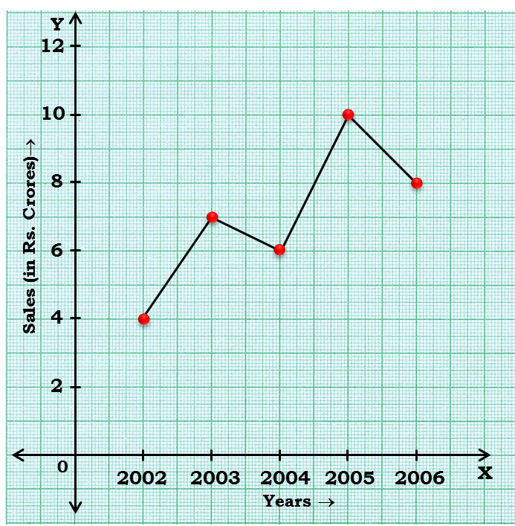
2
The following line graph shows the yearly sales figures for a manufacturing company.
(a) What were the sales in (i) 2002 (ii) 2006 ?
Sol :
The sales in :
(i) 2002 was Rs. 4 crores.
(ii) 2002 was Rs. 8 crores.
8
(b) What were the sales in (i) 2003 (ii) 2005 ?
7
Sol :
The sales in :
6
(i) 2003 was Rs. 7 crores.
(ii) 2005 was Rs. 10 crores.

Slide 7
2
The following line graph shows the yearly sales figures for a manufacturing company.
(c) Compute the difference between the sales
in 2002 and 2006.
Sol :
The difference of sales in 2002 and 2006
=
Rs. 8 crores
– Rs. 4 crores
=
Rs. 4 crores
(d) In which year was there the greatest
difference between the sales as compared
to its previous year ?
Sol :
The difference of sales in 2002 and 2006
=
Rs. 10 crores
– Rs. 6 crores
=
Rs. 4 crores

Slide 8
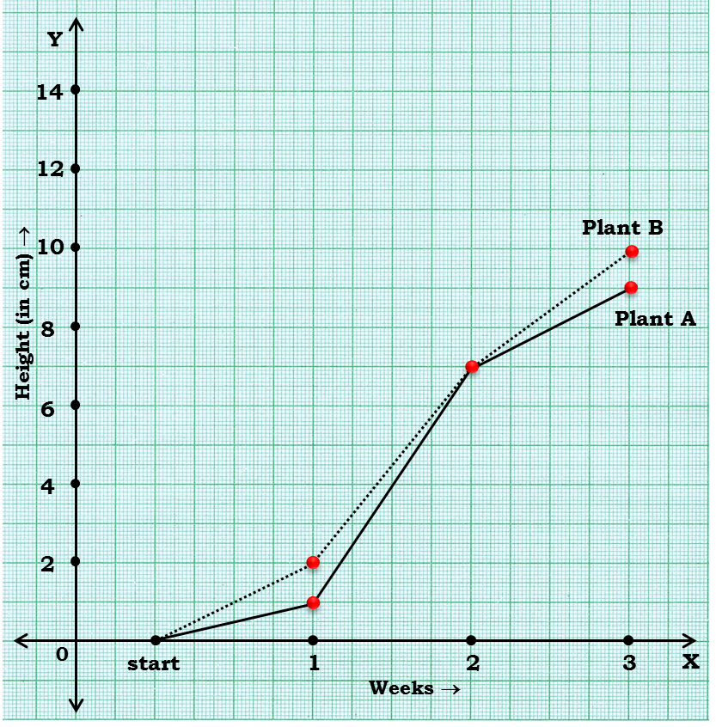
3
For an experiment in Botany, two different plants, plant A and plant B were grown under similar laboratory conditions.
Their height were measured at the end of each week for 3 weeks. The results are shown by the following graph.
(a) How high was plant A after
(i) 2 weeks (ii) 3 weeks ?
Sol :
(i) The plant A was 7 cm high
after 2 weeks and
(ii) After 3 weeks it was 9 cm high.
10
9
8
8
(b) How high was plant B after
(i) 2 weeks (ii) 3 weeks ?
8
7
7
Sol :
(i) The plant A was 7 cm high
after 2 weeks and
6
6
(ii) After 3 weeks it was 10 cm high.

Slide 9
3
For an experiment in Botany, two different plants, plant A and plant B were grown under similar laboratory conditions.
Their height were measured at the end of each week for 3 weeks. The results are shown by the following graph.
(c) How much did plant A grow during the
3rd week ?
Sol :
During the 3rd week, the plant A grew
=
9 cm
– 7 cm
=
2 cm during 3rd week.
10
9
8
8
(d) How much did plant B grow from the
end of the 2nd week to the end of the
3rd week ?
8
7
7
6
6
Sol :
Plant B grew during end of the 2nd week to the end of the 3rd week
=
10 cm
– 7 cm
=
3 cm

Slide 10
3
For an experiment in Botany, two different plants, plant A and plant B were grown under similar laboratory conditions.
Their height were measured at the end of each week for 3 weeks. The results are shown by the following graph.
(e) During which week did Plant A grow
most ?
Sol :
The growth of the plant A :
During the 1st week :
1
– 0
=
1
During the 2nd week :
7
– 1
=
6
10
9
8
During the 3rd week :
9
– 7
=
2
8
8
7
Thus, during the 2nd week,
the plant A grew the most
7
6
6
2
2
1
1
0
0

Slide 11
3
For an experiment in Botany, two different plants, plant A and plant B were grown under similar laboratory conditions.
Their height were measured at the end of each week for 3 weeks. The results are shown by the following graph.
(f) During which week did Plant B grow
least ?
Sol :
The growth of the plant B :
During the 1st week :
2
– 0
=
2
During the 2nd week :
7
– 2
=
5
8
8
During the 3rd week :
10
– 7
=
3
7
7
Thus, during the 1st week,
the plant B grew the least.
6
6
(g) Were the two plants of the same height
during any week shown here ? Specify.
Sol :
At the end of the second week, plant A and B were of the same height.

Slide 12
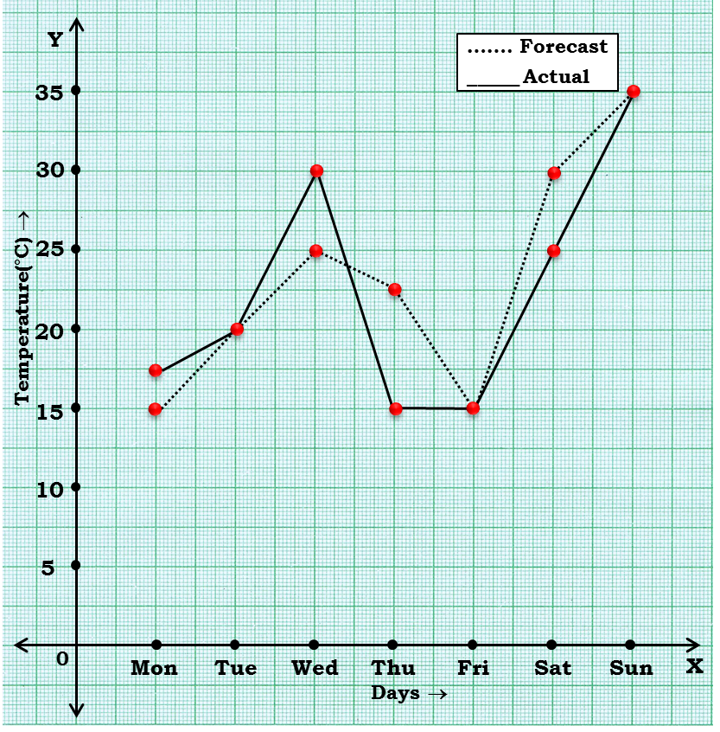
4
The following graph shows the temperature forecast and the actual temperature for each day of a week.
(a) On which days was the forecast
temperature the same as the actual
temperature ?
Sol :
On Tuesday, Friday and Sunday,
The forecast temperature was same as the actual temperature.
(b) What was the maximum forecast
temperature during the week ?
Sol :
The maximum forecast temperature was 35° C.
(c) What was the minimum actual
temperature during the week ?
Sol :
The minimum actual temperature was 15° C.

Slide 13
4
The following graph shows the temperature forecast and the actual temperature for each day of a week.
(d) On which day did the actual
temperature differ the most from
the forecast temperature ?
Sol :
During the Monday :
15
– 17.5
=
2.5
25
During the Wednesday :
25
– 30
=
5
22.5
20
During the Thursday :
15
– 22.5
=
7.5
20
17.5
During the Saturday :
25
– 30
=
5
15

Slide 14


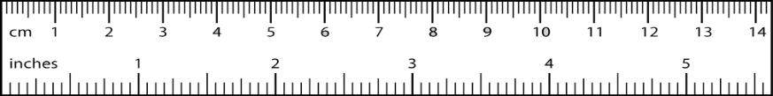
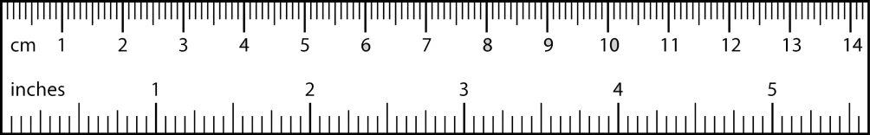
5
Use the tables below to draw linear graphs.
(a) The number of days a hill side city
received snow in different years.
Year
2003
2004
2005
2006
Y
Days
8
10
5
12
Sol :
14
12
10
Since difference is not same we will put krink mark on X-axis
Days→
8
6
6
5
4
2003 – 0
= 2003
4
2
2004 – 2003
= 1
X’
0
2003
2004
2005
2006
X
Y’
Year →

Slide 15
5
14
Use the tables below to draw linear graphs.
14
Y
13
14
13.5
(b) Population (in thousands) of men and
women in a village in different years.
13.2
13
13
12.5
13
12
Year
2003
2004
2005
12
2006
2007
11
No. of Men
12
12.5
13
13.2
13.5
10
No. of Women
11.3
11.9
13
13.6
12.8
9
Sol :
8
Population (in years) →
7
6
5
Since difference is not same we will put krink mark on X-axis
4
3
2
2003 – 0
= 2003
1
2004 – 2003
= 1
X’
0
2003
2004
2005
2006
2007
X
Y’
Year →

Slide 16
5
Use the tables below to draw linear graphs.
14
Y
14
13.6
(b) Population (in thousands) of men and
women in a village in different years.
13
13
12.8
12
13
12
12
11.9
Year
2003
2004
2005
2006
2007
12
11
11.3
No. of Men
12
12.5
13
11
_____ Men
13.2
13.5
10
11
…….. Women
No. of Women
11.3
11.9
13
13.6
12.8
9
Sol :
8
Population (in years) →
7
6
5
4
3
2
1
X’
0
2003
2004
2005
2006
2007
X
Y’
Year →

Slide 17
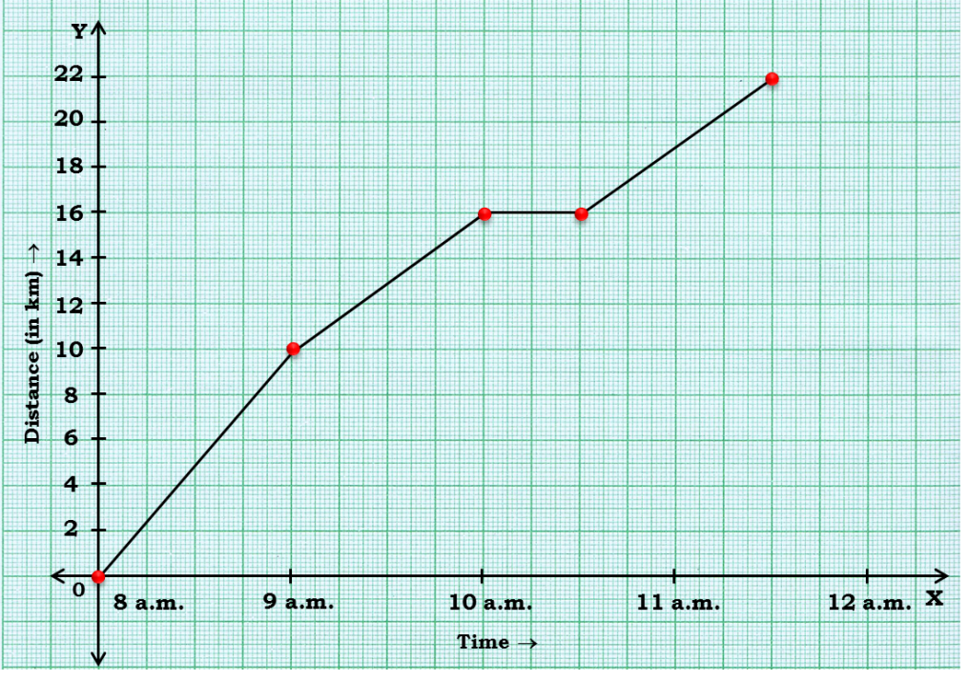
A courier-person cycles from a town to a neighbouring suburban area to deliver a parcel to a merchant. His distance from the town at different times is shown by the following graph.
6
(a) What is the scale taken for the
time axis ?
Sol :
4 units
= 1 hour
(b) How much time did the person take
for the travel ?
Sol :
8
– 11:30
=
3½ hrs
(c) How far is the place of merchant
from the town ?
Sol :
It was 22 km far from the town.
11
11.30
12

Slide 18
A courier-person cycles from a town to a neighbouring suburban area to deliver a parcel to a merchant. His distance from the town at different times is shown by the following graph.
6
(d) Did the person stop on his way ?
Explain.
Sol :
Yes, this has been indicated by the horizontal part of the graph.
He stayed from 10 am to 10:30 am.
(e) During which period did he ride
fastest ?
Sol :
He rode the fastest between 8 am and 9 am.
10
10.30
11

Slide 19
7
Can there be a time-temperature graph as follows ? Justify your answer.
(i)
Temperature→
Time →
Sol :
It is showing the increase in temperature.

Slide 20
7
Can there be a time-temperature graph as follows ? Justify your answer.
(ii)
Temperature→
Time →
Sol :
It is showing the decrease in temperature.

Slide 21
7
Can there be a time-temperature graph as follows ? Justify your answer.
(iii)
Temperature→
Time →
Sol :
The graph figure (iii) is not possible since temperature is increasing very rapidly which is not possible.

Slide 22
7
Can there be a time-temperature graph as follows ? Justify your answer.
(iii)
Temperature→
Time →
Sol :
It is showing constant temperature.

Slide 23
Exercise 15.2

Slide 24
1
Plot the following points on a graph shet. Verify if they lie on a line.
(a) A(4, 0), B(4, 2), C(4, 6), D(4, 2.5)
(b) P(1, 1), Q(2, 2), R(3, 3), S(4, 4)
(c) K(2, 3), L(5, 3), M(5, 5), N(2, 5)
Y
8
7
6
C(4 ,6)
5
4
3
3
2.5
D(4 ,2.5)
2
B(4 ,2)
2
1
A(4 ,0)
X’
0
1
2
3
4
5
6
7
X
Y’

Slide 25
1
Plot the following points on a graph shet. Verify if they lie on a line.
(a) A(4, 0), B(4, 2), C(4, 6), D(4, 2.5)
(b) P(1, 1), Q(2, 2), R(3, 3), S(4, 4)
(c) K(2, 3), L(5, 3), M(5, 5), N(2, 5)
Y
8
7
6
C(4 ,6)
5
4
S(4 ,4)
3
R(3 ,3)
D(4 ,2.5)
2
Q(2 ,2)
B(4 ,2)
1
P(1 ,1)
A(4 ,0)
X’
0
1
2
3
4
5
6
7
X
Y’

Slide 26
1
Plot the following points on a graph shet. Verify if they lie on a line.
(a) A(4, 0), B(4, 2), C(4, 6), D(4, 2.5)
(b) P(1, 1), Q(2, 2), R(3, 3), S(4, 4)
(c) K(2, 3), L(5, 3), M(5, 5), N(2, 5)
Y
8
7
6
C(4 ,6)
N(2 ,5)
5
M(5 ,5)
4
S(4 ,4)
K(2 ,3)
L(5 ,3)
3
R(3 ,3)
D(4 ,2.5)
2
Q(2 ,2)
B(4 ,2)
1
P(1 ,1)
A(4 ,0)
X’
0
1
2
3
4
5
6
7
X
Y’

Slide 27
2
Draw the line passing through (2, 3) and (3, 2). Find the the coordinates of the point at which this line meets the x-axis and y-axis.
Sol :
The coordinates of the points at which this line meets the x-axis at (5, 0) and y-axis at (0, 4.5)
Y
6
5
(0 ,5)
4
3
(2 ,3)
2
(3 ,2)
1
(5 ,0)
X’
0
1
2
3
4
5
X
Y’

Slide 28
3
Write the coordinates of the vertices of each of these adjoining figures.
Sol :
Vertices of figure OABC
O(0, 0)
A(2, 0)
B(2, 3)
C(0, 3)
Y
Vertices of figure PQRS
M
8
P(4, 3)
Q(6, 1)
Q(6, 5)
S(4, 7)
L
7
S
Vertices of figure LMK
6
L(7, 7)
M(10, 8)
K(10, 5)
5
R
K
4
C
B
P
3
2
1
Q
O
A
0
1
2
3
4
5
6
7
8
9
10
X

Slide 29
4
State whether True or False. Correct that are false.
(a) A point whose x coordinate is zero and y-coordinate
is non-zero will lie on the y-axis.
Sol :
True
A point whose y coordinate is zero and x-coordinate
is 5 will lie on y-axis.
Sol :
False, it will lie on x-axis.
(c) The coordinates of the origin are (0, 0).
Sol :
True

Slide 30
Exercise 15.3

Slide 31
1
Draw the graphs for the following tables of values, with suitable scales on the axes.
(a) Cost of apples
No. of apples
1
2
3
4
5
Cost (in Rs)
5
10
15
20
25
Sol :
Y
30
Cost (in Rs.) →
(5, 25)
25
(4, 20)
20
(3, 15)
15
(2, 10)
10
(1, 5)
5
X’
0
1
2
3
4
5
X
Y’
Number of apples →

Slide 32
1
Draw the graphs for the following tables of values, with suitable scales on the axes.
(b) Distance travelled by a car
Time (in hours)
6 a.m.
7 a.m.
8 a.m.
9 a.m.
Distance (in km)
40
80
120
160
Y
240
200
Distance (in km) →
160
120
80
40
X’
0
6 a.m.
7 a.m.
8 a.m.
9 a.m.
X
Y’
Time (in hours) →

Slide 33
1
Draw the graphs for the following tables of values, with suitable scales on the axes.
(b) Distance travelled by a car
Time (in hours)
6 a.m.
7 a.m.
8 a.m.
9 a.m.
Distance (in km)
40
80
120
160
Y
(i) How much distance did the car cover
during the period 7.30 a.m. to 8 a.m. ?
240
Sol :
100
– 120
= 20
200
Distance (in km) →
The car covered 20 km distance.
160
120
120
(ii) What was the time when the car had
covered a distance of 100 km since
its start ?
120
100
100
80
80
80
40
Sol :
At 7.30 am the car had covered 100 km.
X’
0
6 a.m.
7 a.m.
8 a.m.
9 a.m.
X
7.30
7
7.30
8
Y’
7
8
Time (in hours) →

Slide 34
1
Draw the graphs for the following tables of values, with suitable scales on the axes.
(c) Interest on deposits for a year
Deposite (in Rs.)
1000
2000
3000
4000
5000
Simple Interest (in Rs.)
80
160
240
320
400
Y
(5000, 400)
400
(4000, 320)
Deposite (in Rs.) →
320
(3000, 240)
240
(2000, 160)
160
(1000, 80)
80
X’
0
1000
2000
3000
4000
5000
X
Y’
Simple Interest (in Rs.) →

Slide 35
1
Draw the graphs for the following tables of values, with suitable scales on the axes.
(c) Interest on deposits for a year
Deposite (in Rs.)
1000
2000
3000
4000
5000
Simple Interest (in Rs.)
80
160
240
320
400
(i) Does the graph pass through the
origin ?
Y
Sol :
Yes, the graph passes through the origin.
(5000, 400)
400
(4000, 320)
320
Deposite (in Rs.) →
240
(3000, 240)
(ii) Use the graph to find the interest
on Rs. 2500 for a year.
240
200
(2000, 160)
160
Sol :
Interest on Rs. 2500 is Rs. 200 for a year.
160
(1000, 80)
80
X’
0
1000
2000
3000
4000
5000
X
Y’
2000
2500
3000
Simple Interest (in Rs.) →

Slide 36
1
Draw the graphs for the following tables of values, with suitable scales on the axes.
(c) Interest on deposits for a year
Deposite (in Rs.)
1000
2000
3000
4000
5000
Simple Interest (in Rs.)
80
160
240
320
400
(iii) To get an interest of Rs. 280 per
year, how much money should be
deposited ?
Y
(5000, 400)
320
400
Sol :
Rs. 3500 should be deposited for interest of Rs. 280.
(4000, 320)
320
Deposite (in Rs.) →
280
(3000, 240)
240
240
(2000, 160)
160
(1000, 80)
80
X’
0
1000
2000
3000
4000
5000
X
Y’
3000
3500
4000
Simple Interest (in Rs.) →

Slide 37
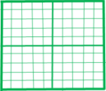
2
Draw the graphs for the following
(i)
Side of Square (in cm)
2
3
3.5
5
6
Perimeter (in cm)
8
12
14
20
24
Is it linear graph ?
Sol :
Yes, it is a linear graph
Y
28
24
(6, 24)
16
20
(5, 20)
16
Perimeter (in cm) →
14
(3.5, 14)
12
12
(3, 12)
8
(2, 8)
4
X’
0
1
2
3
4
5
6
7
X
Y’
3
3.5
4
Side of square (in cm) →

Slide 38
2
Draw the graphs for the following
(ii)
Side of Square (in cm)
2
3
4
5
6
Perimeter (in cm)
4
9
16
25
36
Is it linear graph ?
No, it is not a linear graph because the graph does not provide a straight line.
Y
Sol :
40
40
35
(6, 36)
36
35
30
20
25
(5, 25)
20
Perimeter (in cm) →
16
15
(4, 16)
15
10
10
(3, 9)
9
5
5
(2, 4)
4
5
X’
0
1
2
3
4
5
6
X
0
Y’
Side of square (in cm) →

Slide 39
Additional sums

Slide 40
1
Write the co-ordinates of the vertices of the following figure :
Sol.
Vertices of figure ABCD
Y
10
C
A(3, 2)
B(10, 6)
C(11, 10)
D(4, 6)
R
9
8
7
Q
D
6
B
5
4
3
P
2
A
1
L
K
M
N
0
1
2
3
4
5
6
7
8
9
10
11
12
13
X

Slide 41
Plot the points A(3, 0), B(5, 0) and C(8, 0). What do you observe where do they lie ? Also, plot the points P(0, 2), Q(0, 5) and R(0, 9). Do they lie on x-axis ?
2
10
9
Sol :
8
7
6
5
4
3
2
1
A(3 ,0)
B(5 ,0)
C(8 ,0)
X’
0
1
2
3
4
5
6
7
8
9
10
X
Y’

Slide 42
Plot the points A(3, 0), B(5, 0) and C(8, 0). What do you observe where do they lie ? Also, plot the points P(0, 2), Q(0, 5) and R(0, 9). Do they lie on x-axis ?
2
10
9
C(0 ,9)
Sol :
8
7
6
5
B(0 ,5)
4
3
2
A(0 ,2)
1
A(3 ,0)
B(5 ,0)
C(8 ,0)
X’
0
1
2
3
4
5
6
7
8
9
10
X
Y’

Slide 43
Plot the points A(10, 50), B(15, 20) and C(40, 10) and D(60, 80) on the graph paper
3
100
Sol :
90
80
D(60 ,80)
70
60
50
A(10 ,50)
40
30
20
B(15 ,20)
10
C(40 ,10)
X’
10
20
30
40
50
60
70
80
90
X
0
100
Y’

Slide 44
Plot any three points such that x-coordinate of each point is equal to its y-co-ordinate. Join these points in pairs. Do they lie on a line passing through the origin ?
4
10
9
Sol :
8
C(8 ,8)
7
6
5
B(5 ,5)
4
3
2
A(2 ,2)
1
X’
1
2
3
4
5
6
7
8
9
X
0
10
Y’

Slide 45
The graph shown in figure exhibits the rate of interest on fixed deposits upto one year announced by the reserved Bank of India in different years. Read the graph and find
5
(i) In which period was the rate of
interest maximum ?
Y
14
Sol :
The rate of interest was
maximum (12 %) in 1996.
12
10
8
(b) In which period was the rate of
interest minimum ?
Rate of interest per annum →
8
6.5
6
Sol :
The minimum rate of interest
was 6.5 % in the year 2002.
6
4
2
0
X
1992
1993
1994
1995
1996
1997
1998
1999
2000
2001
2002
Years →

Slide 46
6
Given below is the temperature chart of a patient.
(i) Find the temperature of the patient at
12:00 hours and 18:00 hours
Y
Sol :
The temperature of the patient at 12:00 hours is 100°F.
105
104
and at 18:00 hours the temperature is 98°F.
103
102
(b) At what time is the temperature
(i) highest ? (ii) lowest ?
101
Temperature (°F) →
Sol :
(i) The maximum temperature of
the patient is 104°F at 14:00
hours.
100
99
98
(ii) the minimum temperature of
the patient is 98°F at 18:00
hours.
97
0
X
8:00
10:00
12:00
14:00
16:00
18:00
20:00
22:00
Time (in hours) →

Slide 47
The maximum temperature on 10 days of June, 2002, in Delhi is given below :
7
Y
Date
Max. temp. (in °C) :
45
Temperature-time graph
1
40.5
2
41
44
3
39
4
40
43
5
42
6
43
42
7
44
41
41
8
40
Temperature (in °F) →
40.5
9
38
40
10
39
40
Draw a temperature-time graph for the above data.
39
38
37
X’
0
1
2
3
4
5
6
7
8
9
10
X
Y’
Dates of June 2002 →

Slide 48
A car is going for a long journey of 16 hours, starting at 5:00 hrs. The speeds of the car at different hours are given below :
8
Time (in hours)
Speed(in km/hour):
5:00
40
Velocity-time graph
7:00
50
Y
9:00
60
11:00
80
80
13:00
70
15:00
65
70
17:00
75
60
19:00
60
Speed Velocity (in km/hr) →
21:00
50
50
Draw a velocity-time graph for the above data.
40
30
X’
0
1:00
X
3:00
5:00
7:00
9:00
11:00
13:00
15:00
17:00
19:00
21:00
Y’
Time (in hours) →

Slide 49
Q
The following graph shows temperature of a patient in a hospital, recorded every hour.
(a) What was the patient’s temperature at 1 p.m. ?
Sol :
Y
10
C
R
9
8
7
Q
D
6
B
5
4
3
P
2
A
1
L
K
M
N
0
1
2
3
4
5
6
7
8
9
10
11
12
13
X

